Slide 1
SMART BIN ALERT SYSTEM
“Green society”
Team Member: Gurusarvesh S

Slide 2
The Problem We Aim to Solve
Overflowing bins in places like canteens, classrooms, and staff rooms create health hazards and unpleasant environments.
Manual waste collection is inefficient:
Bins are emptied at fixed times, regardless of fill level.
Some bins overflow before pickup, while others are empty.
No real-time visibility of bin status for cleaning staff or administration.
👉 Need for a smart, efficient, and real-time solution.

Slide 3
Literature review
Earlier and recent iot enabled smart bins
1 .IoT enabled smart bins indicates fill-level and uses motion sensors
Wireless communication protocols for real time data transfer
ML : SVM, KNN for waste classification
Enables campus cleanliness by predictive analytics
IoT-Driven Smart Waste Management System for Smart... - Google Scholar
2 .IoT sensors indicates fill levels.
GSM module sends SMS alerts
used Arduino for control
Effective Smart Bin Monitoring System using Arduino and GSM Module | IEEE Conference Publication | IEEE Explore
3 .IoT Devices: Ultrasonic and temperature sensors to indicate bin levels
Microcontroller: Atmega328P manages sensor data and system control
Communication: wifi module transmit data to MQTT protocol then saved in server
IoT-Integrated Smart Waste Management System with Real-Time Monitoring and Fault Detection | IEEE Conference Publication | IEEE Explore
Disadvantages
High Setup Costs: for smart bins, sensors, and wireless communication, GSM modules , maintenance
for large campuses.
Sensor Maintenance: Sensors will malfunction in case of battery drain ,temperature, signal issues, requiring regular checks
Network: Real-time tracking , SMS alerts depends on stable internet or local network
Model Limitations: ML algorithms will misclassify waste types if the input data is inconsistent.
Data Privacy: IoT systems collect vast data on locations, timing so secure storage and authorized access is needed
Integration Complexity: : Connecting different building can be technically challenging .

Slide 4
Our Smart Solution at a Glance
Smart Bin System with IoT & Web Dashboard
Ultrasonic Sensor detects the fill level of the bin.
NodeMCU Microcontroller sends the sensor data using WiFi.
Thingspeak Cloud Platform displays bin status and alerts.
Web Dashboard for real-time monitoring by cleaning staff.
Analytics and Alerts to optimize collection schedules and manpower.
Outcome: A cleaner, smarter, and more responsive waste management process

Slide 5
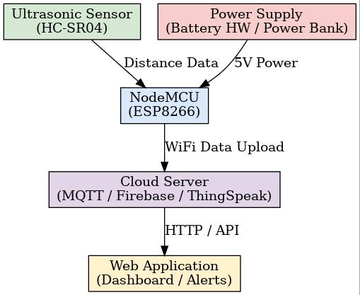
System Architecture
Diagram:
Sensor detects fill level (in cm).
NodeMCU processes data and sends it to Thingspeak via MQTT protocol.
Data is visualized on a custom web dashboard (built using PHP/HTML/CSS).
Alerts sent via email/popup when bin is nearly full.
Admin/staff plan collection based on real-time data.

Slide 6
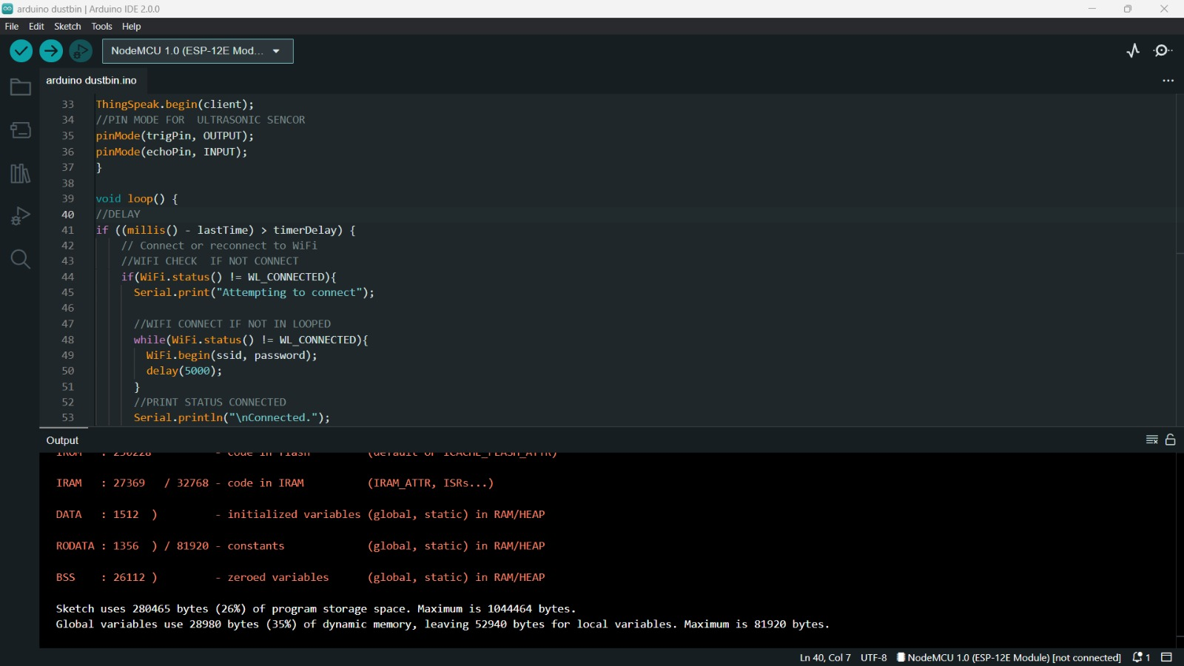
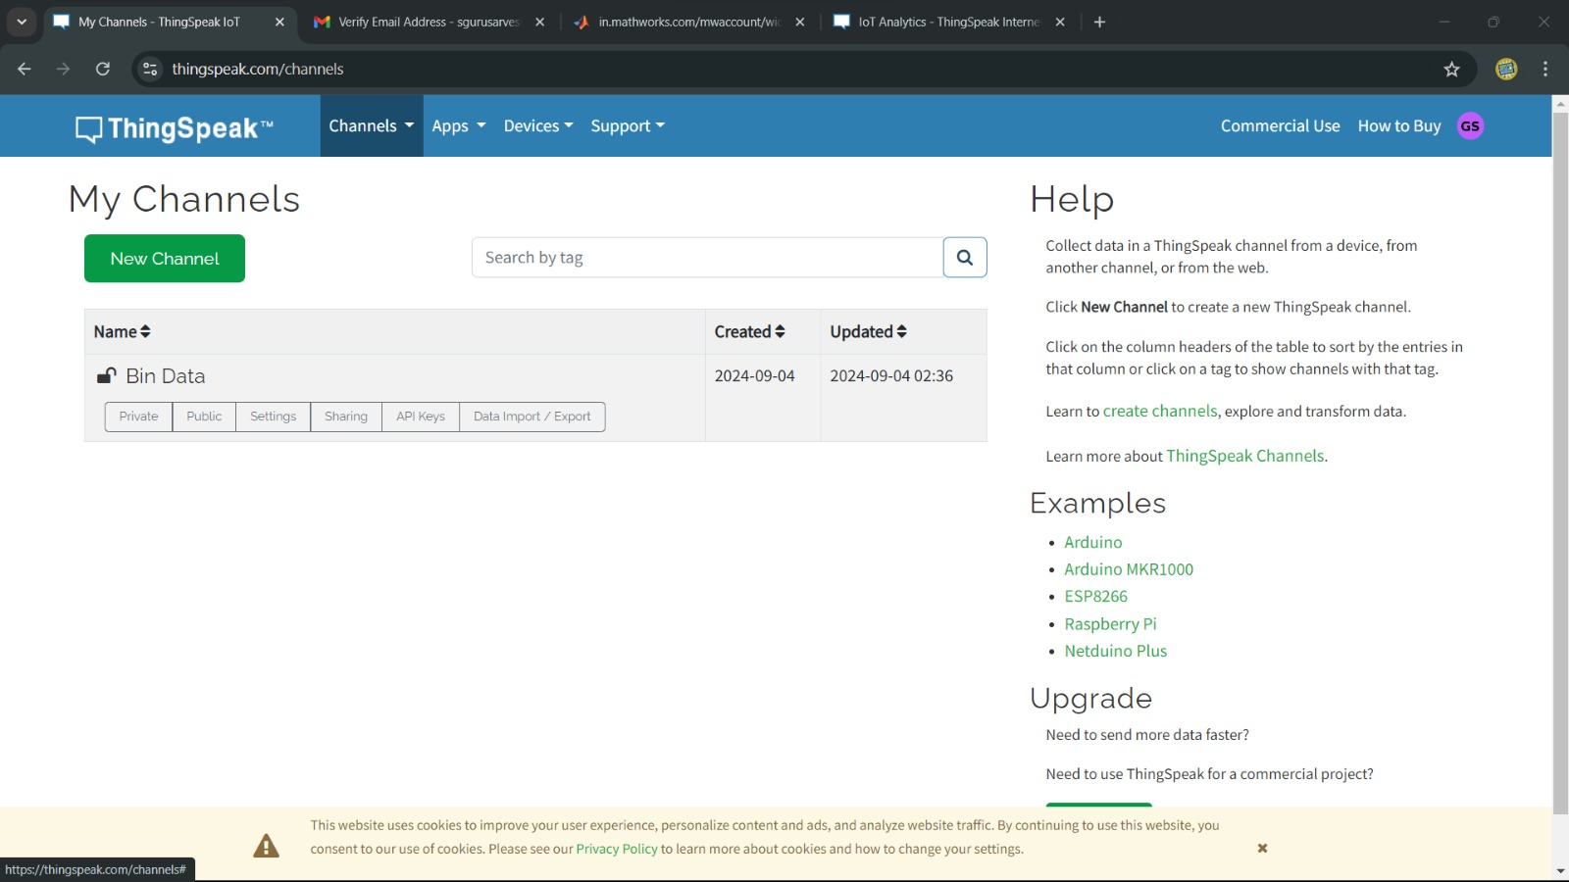
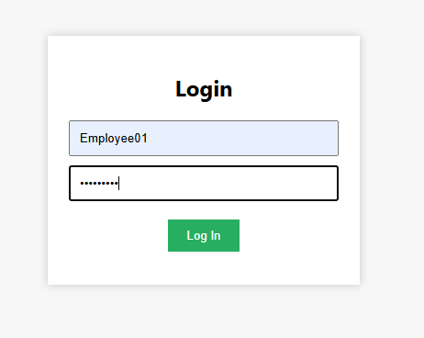
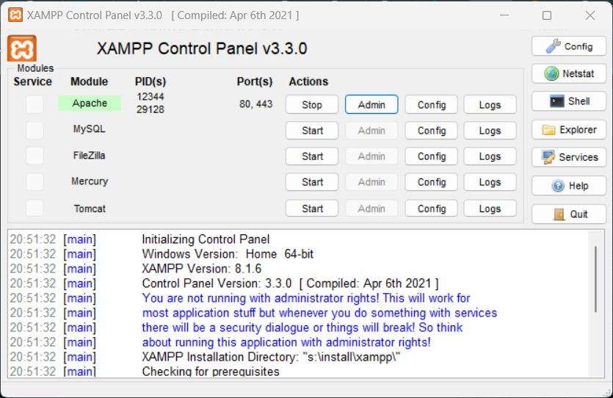
Technology Stack
Software Components:
Frontend: HTML, CSS, JavaScript
Backend: PHP + MySQL + XAMPP
IoT Platform: Thingspeak Server
(MQTT protocol)
Hardware Components:
NodeMCU (ESP8266 Wi-Fi module)
Ultrasonic Sensor (HC-SR04)
Rechargeable Power bank/Battery
Programming Languages:
Embedded C for firmware (NodeMCU)
PHP for backend integration
Fig1. Compiling Dustbin code
Fig2. Configuring Thinkspeak
Fig3. Configuring xampp
Fig4. Developed web

Slide 7
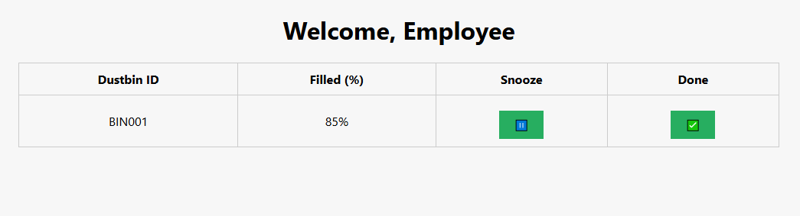
Prototype Development
images/screenshots with brief captions
Sensor Setup: Ultrasonic sensor mounted in bin
Firmware Code: C program to calculate fill percentage
Cloud Configuration: Thingspeak MQTT settings
Web Dashboard: Live data, bin status, alerts
Testing Output: Simulated bin fills triggering alerts

Slide 8
Key Advantages of Our Model
Challenge | Existing Models | Our Smart Bin
Real-time Monitoring | Not Available | ✅ Yes
Cost | High | ✅ Low-Cost Prototype
Alerts | Manual Checking | ✅ Auto notification
User Interface | Often Missing | ✅ Full Web Dashboard
Data Insights | No | ✅ Trends & Analytics
✅ Additional Edge: Scope for AI/ML and solar integration

Slide 9
Feasibility & Cost Estimation
Component | Cost (INR)
NodeMCU | ₹300
Ultrasonic Sensor | ₹200
Power bank/HW battery | ₹500/30
Other Materials | ₹40
Total | ₹1070-570
✅ Easily scalable for campuses, malls, and municipalities.
✅ Uses open-source tools for minimal operating cost.

Slide 10
Sustainability & Social Impact
Reduces unnecessary fuel use for bin pickup trucks.
Promotes a cleaner campus and urban environment.
Aligns with Swachh Bharat, Smart City, and Sustainable Development Goals (SDGs).
Encourages data-driven decisions in public sanitation.
Prevents overflow and contamination in public spaces.

Slide 11
Challenges Faced & Our Solutions
Type | Challenge | Our Solution
Technical | Sensor Inaccuracy | Calibration, test cycles
Operational | Power issues | Rechargeable battery or solar
User Behavior | Mishandling | QR code for feedback & awareness
Scalability | Too many bins | Use analytics to group by priority

Slide 12
Future Scope and Enhancements
🧠 ML Algorithm to predict bin fill times
🌞 Solar Charging Module for off-grid operation
📱 Mobile App for staff on Android/iOS
🧪 Odor/Gas Sensor for foul smell detection
📊 Predictive Analysis for manpower planning
📌 Citizen Feedback via QR Code on bin

Slide 13
What We Learned From citations ?
“From our research on 3 citations, we realized the value of real-time monitoring and intelligent alerts. However, we also noticed that these commercial systems are often expensive and inaccessible for smaller institutions or rural areas.”

Slide 14
How Our Model Builds On That
Feature | citations | Our Model
Cost | High | Low-cost (₹1070 per unit)
Platform | Proprietary | Open-source (Thingspeak, XAMPP)
Access | Commercial | DIY/Academic deployment
Customization | Limited | Highly customizable (dashboard, alerts, future scope)
So, while Google scholar is a great benchmark, our model is more accessible, affordable, and flexible—especially for campuses and smaller organizations

Slide 15
Key Message
✅ We’ve benchmarked our model against real-world solutions, and while inspired by them, we aim to offer a more practical, budget-friendly, and scalable smart bin system.

Slide 16
Thank You! Let’s build cleaner cities with smarter bins.

Slide 17
THANK YOU

